Slide 1
SYED HASAN SAEED
Email: hasansaeedcontrol@gmail.com
Web Page: hasansaeed872726549.wordpress.com
shasansaeed.yolasite.com

Slide 2
BOOKS
AUTOMATIC CONTROL SYSTEM: KUO & GOLANARAGHI
2. CONTROL SYSTEM: ANAND KUMAR
3. AUTOMATIC CONTROL SYSTEM: S. HASAN SAEED
ELECTRICAL MACINE & AUTOMATIC CONTROL: J.B.GUPTA & S. HASAN SAEED
AUTOMATIC CONTROL SYSTEM: R. A . BARAPATE

Slide 3
THERMAL SYSTEM

Slide 4
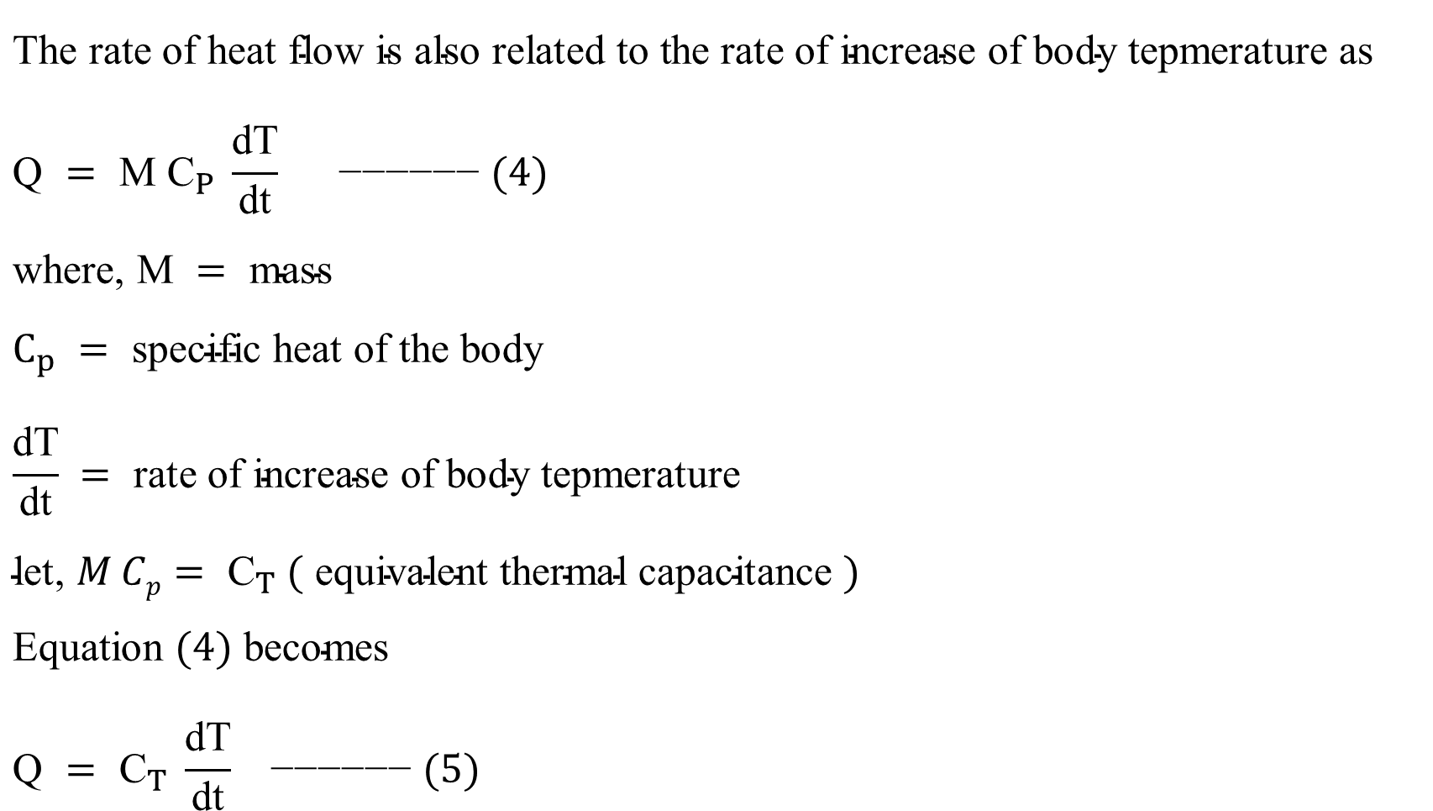
THERMAL SYSTEM
$$\text{The} \text{rate} \text{of} \text{heat} \text{flow} \text{is} \text{also} \text{related} \text{to} \text{the} \text{rate} \text{of} \text{increase} \text{of} \text{body} \text{tepmerature} \text{as} \\ \text{Q} = \text{M} {\text{C}}_{P} \frac{\text{dT}}{\text{dt}}\text{ −−−−−− }(4) \\ \text{where}\text{, }\text{M} = \text{mass} \\ C_{p} = \text{specific} \text{heat} \text{of} \text{the} \text{body} \\ \frac{\text{dT}}{\text{dt}} = \text{rate} \text{of} \text{increase} \text{of} \text{body} \text{tepmerature} \\ \text{let}\text{, }M Cp= {\text{C}}_{T} ( \text{equivalent} \text{thermal} \text{capacitance} ) \\ \text{Equation} (4) \text{becomes} \\ \text{Q} = {\text{C}}_{T} \frac{\text{dT}}{\text{dt}}\text{ −−−−−− }(5)$$

Slide 5
THERMAL SYSTEM

Slide 6
THERMAL SYSTEM
TEMPERATURE-VOLTAGE ANALOGY
THERMAL | ELECTRICAL
Temperature T _{a} | Voltage E
Heat flow rate Q(t) | Current I
Thermal Resistance R_{T} | Electrical Resistance R
Thermal Capacitance C_{T} | Electrical Capacitance C

Slide 7
THERMAL SYSTEM
RC CIRCUIT (VOLTAGE SOURCE)

Slide 8
THERMAL SYSTEM
TEMPERATURE- CURRENT ANALOGY
THERMAL SYSTEM | ELECTRICAL
Temperature T(t) | Current i
Heat Flow Rate Q(t) | Voltage e
Thermal Resistance R(t) | Electrical Compliance (Conductance G) 1/ R
Thermal Capacitance C_{T} | Electrical Inductance L

Slide 9
THANK YOU

